Slide 1
5.5 Weighted Regression

Slide 2
Because regression cost functions are *summable over individual points* we can - as we will see in this Section - weight individual points in order to emphasize or de-emphasize their importance to a regression model.
This is called *weighted regression*.

Slide 3
Dealing with duplicates

Slide 4
Imagine we have a linear regression dataset that contains multiple copies of the same point, which can occur in a variety of contexts including:
experimental data (e.g., in physics, medicine, etc.): if a repeated experiment produces the same result.
metadata-type datasets (e.g., census, customer databases): due to necessary / helpful pre-processing that quantizes (bins) input features in order to make human-in-the-loop analysis of the data / modeling easier.

Slide 5
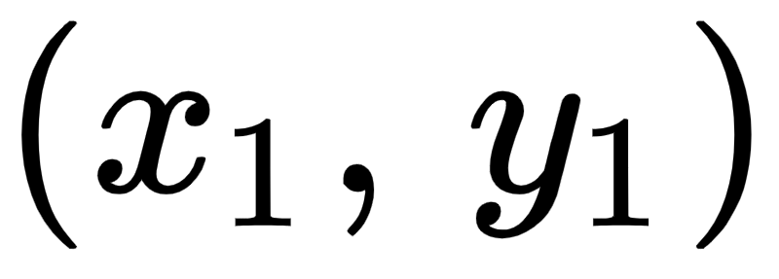
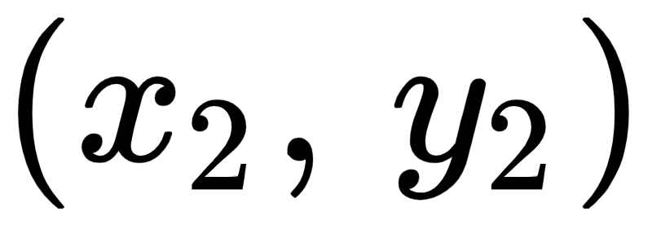
In such instances 'duplicate' datapoints should not be thrown away, since they accurately represent the true phenomenon under study.
If we examine any regression cost function over such a dataset (i.e., one with repeated entries) we can see that it naturally collapses into a weighted version itself.
For example, let us examine the Least Squares cost and suppose that our first two datapoints and are identical.

Slide 6
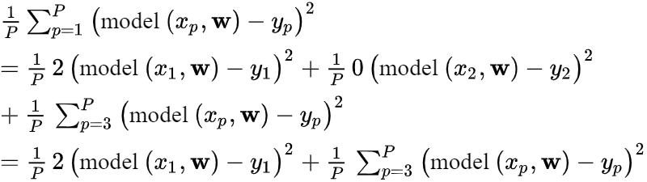
In this instance -- using our `model` notation -- the first two summands of our cost function (in the first two datapoints) can be combined since they will always take on the same value

Slide 7
Here we can see that the cost function naturally collapses so that a repeated point in a dataset is represented in the cost function by a single weighted summand.
Of course this holds more generally as well.
If we examined a regression cost function of a dataset having any number of identical points then we can collapse the summands of this cost for each set of identical points just as we have seen here.

Slide 8
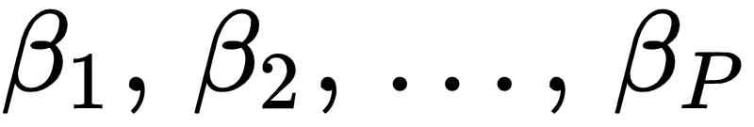
In general this leads to the notion that each term in a regression cost can be weighted to reflect repeated points.
We can write such a weighted regression Least Squares as
Here are point-wise weights.

Slide 9
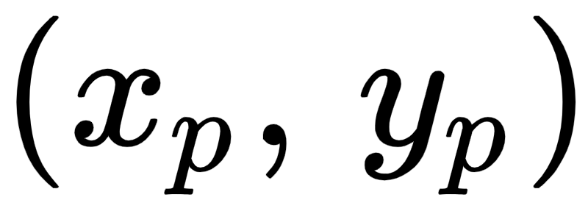
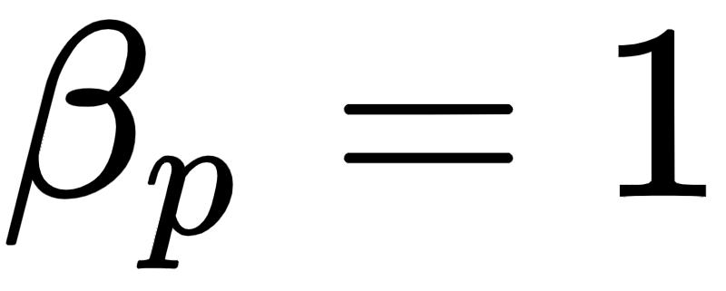
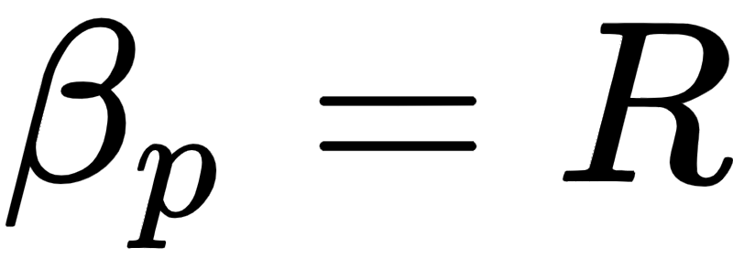
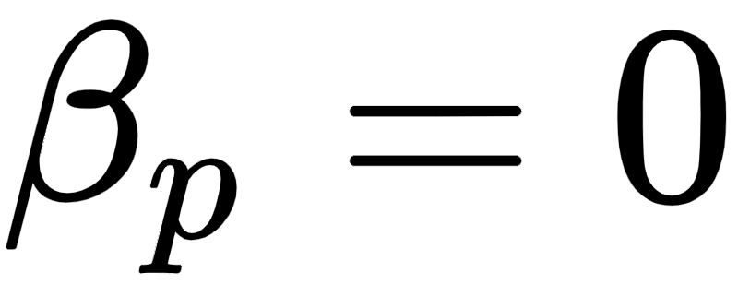

That is, a unique point in the dataset has weight whereas if this point is repeated R times in the dataset then one instance of it will have weight while the others have weight .
Since these weights are fixed (i.e., they are not parameters that need to be tuned, like ) we can minimize a weighted regression cost precisely as we would any other.

Slide 10
Weighting points by confidence

Slide 11
Weighted regression can also be employed when - given knowledge of the process generating a dataset - we want to weight each point based on our confidence on the trustworthiness of each datapoint.
For example if our dataset came in two batches - one batch from a trustworthy source and another from a less trustworthy source (where some datapoints could be noisy or fallacious) - we would want to weight datapoints from the trustworthy source more in our final regression.

Slide 12
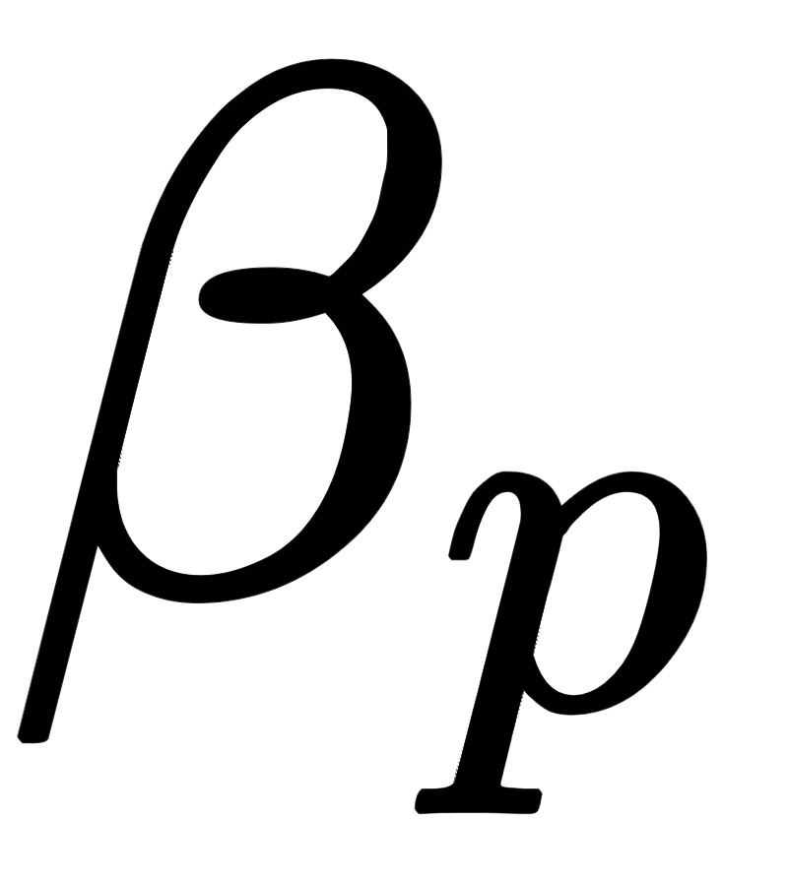
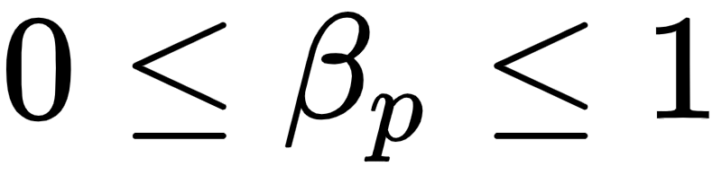
We can do this very easily using precisely the weighted regression paradigm introduced above, only now we set the weights ourselves based on our confidence of each point.
If we believe that a point is very trustworthy we can set its corresponding weight closer to 1, and the more untrustworthy we find a point the smaller we set in the range where implies we do not trust the point at all.
In making these weight selections we of course determine how important each datapoint is in the training of the model.

Slide 13
Below we show the result of increasing the confidence / weight on a single point in a toy dataset.
and how this effects a fully trained regression model on a toy linear regression dataset.
This single point is colored red and we show its diameter increasing and as we increase its corresponding weight .
With each weighting a weighted Least Squares cost is completely minimized over the entire dataset, and resulting line fit to data (and shown in black).

Slide 14
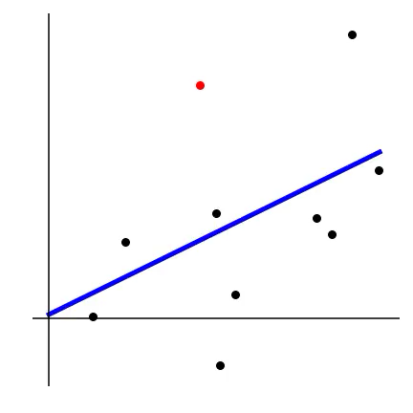

Slide 15
The higher the weighting of this single point, the more we incentivize a linear regressor to fit to it.
If we increase its weight enough the fully trained regression model naturally starts fitting to this single datapoint alone (disregarding all other points).

